Slide 1


Securities Trading and Settlement Process
This presentation will guide you through the intricate process of securities trading and settlement in capital markets, exploring the T+2 timeline, key stages, and associated risks.
AM
by Anoop Mohanty

Slide 2


T+2 Settlement Cycle: Understanding the Timeline
1
Day 0: Trade Execution
Buyers and sellers agree on the price and quantity of securities to be exchanged.
2
Day 1: Confirmation and Clearing
The trade is confirmed and cleared through a clearing house, which guarantees the transaction.
3
Day 2: Settlement
Securities and funds are exchanged between the buyer and seller, completing the transaction.

Slide 3
Trade Execution and Confirmation
Trade Execution
Confirmation
Trade Reporting
Buyers and sellers use brokerage platforms or exchanges to enter orders and execute trades.
Both parties confirm the trade details, including the price, quantity, and settlement date.
The transaction is reported to regulators and other relevant parties for transparency and oversight.

Slide 4

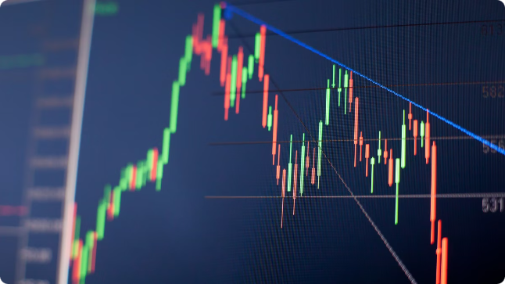
Clearing and Novation
1
Clearing House Role
2
Novation Process
A clearing house acts as a central counterparty, guaranteeing the transaction and reducing counterparty risk.
The clearing house becomes the buyer to the seller and the seller to the buyer, replacing the original parties.
3
Margin Requirements
4
Risk Management
Clearing houses monitor market risks and take measures to mitigate potential losses, ensuring market integrity.
The clearing house requires margin deposits from both parties to ensure financial stability and mitigate losses.

Slide 5




Securities Pay-in Process
Buyer's Obligation
The buyer is obligated to deliver the agreed-upon funds to the clearing house by the settlement date.
Funds Transfer
Funds are transferred from the buyer's account to the clearing house through electronic payment systems.
Clearing House Verification
The clearing house verifies the funds received and confirms the buyer's fulfillment of obligations.

Slide 6


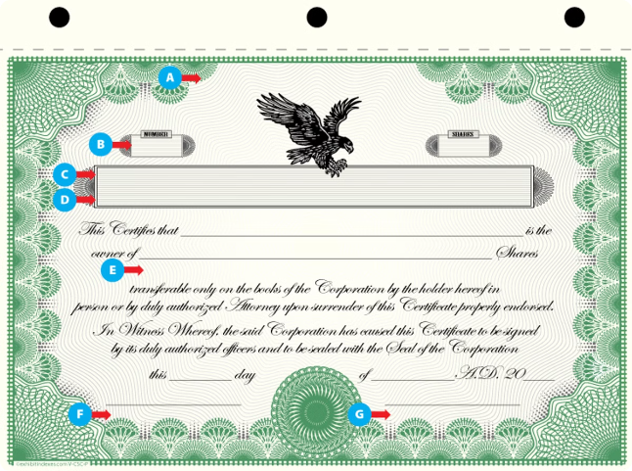

Securities Pay-out Process
Seller's Obligation
The seller is obligated to deliver the agreed-upon securities to the clearing house by the settlement date.
Securities Delivery
Securities are delivered to the clearing house through electronic transfer or physical delivery, depending on the type of security.
Clearing House Verification
The clearing house verifies the securities received and confirms the seller's fulfillment of obligations.

Slide 7

Cash Pay-in Process
Seller's Receipt
The seller receives payment from the clearing house for the sold securities.
Funds Transfer
Funds are transferred electronically from the clearing house to the seller's account.
Settlement Confirmation
The seller receives confirmation of the payment and the successful completion of the transaction.

Slide 8



Cash Pay-out Process
Buyer's Receipt
The buyer receives the purchased securities from the clearing house.
Securities Delivery
Securities are delivered electronically or physically, depending on the type of security.
Settlement Confirmation
The buyer receives confirmation of the securities delivery and the successful completion of the transaction.

Slide 9

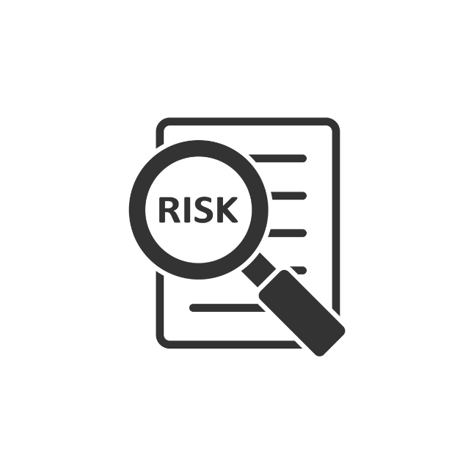
Risks and Challenges in the Settlement Process
Counterparty Risk
Operational Risk
The risk that one party to the transaction may default on their obligation.
The risk of errors, delays, or disruptions in the settlement process.
Regulatory Compliance
Market Volatility
The risk of non-compliance with regulations, leading to penalties or legal action.
Fluctuations in market prices can impact the settlement process and create uncertainties.

Slide 10

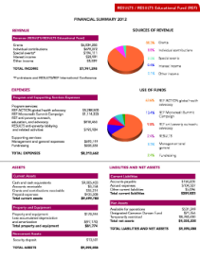




Conclusion and Key Takeaways
Process Understanding
Risk Management
Market Efficiency
Collaboration
A thorough understanding of the trading and settlement process is crucial for participants in the capital markets.
Effective risk management practices are essential to mitigate potential losses and ensure smooth transactions.
The T+2 settlement cycle contributes to market efficiency by facilitating timely and reliable transactions.
Collaboration among market participants, including clearing houses, regulators, and intermediaries, is crucial for a smooth settlement process.

